Slide 1
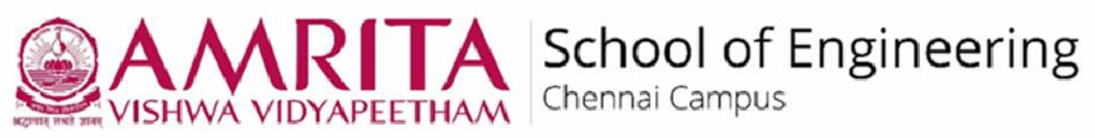

Department of Computer Science and Engineering (Artificial Intelligence) Image Enhancement using DRL Techniques And IVT
Team.No: B13
Korrayi Saiteja CH.EN.U4AIE21122
Harshitha M CH.EN.U4AIE21115
B S S Chaitanya CH.EN.U4AIE21108

Slide 2
PROBLEM STATEMENT
To improve the quality and adaptability of report generation by leveraging Deep Q-Network (DQN) algorithms and Inverse Variance Transformation (IVT). Traditional reporting methods lack with dynamic data patterns, leading to static, less informative outputs. By using DQN, the system will autonomously learn to adjust report parameters based on data insights, enhancing relevance and usability. IVT will ensure balanced feature variances, improving statistical accuracy and interpretability. This approach enables adaptive, statistically sound reporting that can better serve decision-making needs in complex data environments.

Slide 3
OBJECTIVE’s
To apply Inverse Variance Transformation (IVT) to balance feature variances, ensuring reports are statistically reliable and easier to interpret.
To enable the DQN to autonomously select key report features and insights, minimizing manual intervention and optimizing report quality.
To Deliver high-quality, adaptive reports that support informed decision-making by providing clear, relevant insights from complex datasets.

Slide 4
LITERATURE SURVEY
S.No | Title | Author & publication year | Models | Merits | Dataset | Research Gap
1. | Infrared star image denoising using regions with deep reinforcement learning | Zhenduo Zhang, 2021 | Regions with Deep Reinforcement Learning (RDRL), Star Region Extraction Module (SREM).Star Region Extraction Module (SREM), LSTM | Enhanced accuracy in star detection under noise; adaptive approach preserves image quality with fewer artifacts. | Infrared star images captured via Mercury Cadmium Telluride (MCT) infrared camera. | Existing denoising methods lack robustness in maintaining star targets' details under noise variations.
2. | R3L: Connecting Deep Reinforcement Learning to Recurrent Neural Networks for Image Denoising via Residual Recovery | Rongkai Zhang, 2021 | DRL-based Q-network, CNN-based R-network, Asynchronous Advantage Actor-Critic (A3C). | Offers fine-tuned control of noise removal in different image regions, reducing over-smoothing in high-detail areas. | Various synthetic noisy images for model evaluation. | Standard methods struggle to remove noise under different levels of noise accurately.
3. | Learning to Scan: A Deep Reinforcement Learning Approach for Personalized Scanning in CT Imaging | Ziju Shen, 2022 | Proximal Policy Optimization (PPO), GRU-based network. | Reduces patient exposure with personalized scanning, maintains image quality; efficient for high-dimensional data. | 350 CT images, synthetic and patient data. | Traditional CT imaging does not optimize scan angles and dose allocations to individual patient needs, risking unnecessary exposure.
4. | Invertible Network for Unpaired Low-Light Image Enhancement | Jize Zhang, 2023 | Invertible Neural Network (INN), Checkerboard-based Affine Coupling layers. | High-quality enhancement without artifacts, reversible transformations enable improved color and texture preservation. | Unpaired low-light and normal-light image sets. | Conventional methods fail to handle detail preservation and over-exposure in low-light enhancement.

Slide 5
S.No | Title | Author & year | Models | Merits | Dataset | Research Gap
5. | Adaptive Incident Radiance Field Sampling and Reconstruction Using Deep Reinforcement Learning | Yuchi Huo, 2020 | DRL-based Q-network for adaptive sampling, CNN-based R-network. | Adaptive sampling reduces computational load, improves reconstruction accuracy for radiance fields. | Simulated radiance fields. | Prior sampling methods are inefficient in high-complexity scenes, leading to excessive computation time.
6. | DRL-FVRestore: An Adaptive Selection and Restoration Method for Finger Vein Images Based on Deep Reinforcement Learning | Ruoran Gao, 2023 | DRL-based selection for deblurring and denoising, DeblurGAN-v2, Inpainting Network. | Improved vein visibility and restoration accuracy; the model adapts to varied imaging conditions. | MMCBNU_6000, FV-USM, UTFVP, SDUMLA-FV datasets. | Existing methods fail to address variability in finger vein image quality under different conditions.
7. | RePNP: Plug-and-Play with Deep Reinforcement Learning Prior for Robust Image Restoration | Chong Wang, 2023 | DRL-based Plug-and-Play framework, Fully Convolutional Network (FCN), Proximal Policy Optimization (PPO). | Robust to model deviations and effective in image restoration with fewer parameters than conventional PnP models. | Berkeley Segmentation Dataset (BSD) for training, Gaussian noise models for evaluation. | Plug-and-play methods lack robustness in handling model deviations and varied noise types.
8. | Generative Invertible Quantum Neural Networks | Armand Rousselot, 2023 | Quantum Invertible Neural Network (QINN), Classical INN for comparison. | Efficient in generating and reconstructing complex data, with fewer parameters needed than classical counterparts. | Simulated Large Hadron Collider (LHC) data using MADGRAPH5. | Quantum networks lack efficient generative capabilities for high-dimensional physical data.

Slide 6
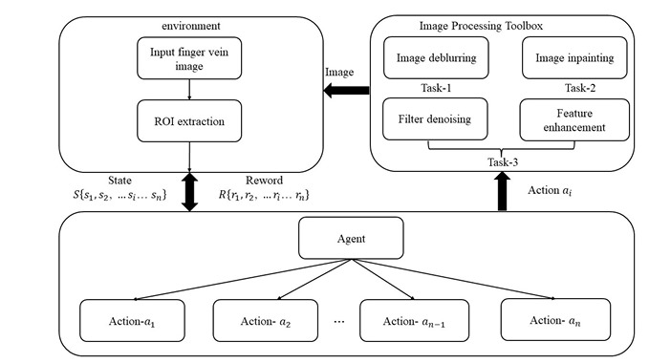
ARCHITECTURE

Slide 7
NOVELTY
Unique Integration of DQN and IVT: This project combines Deep Q-Network (DQN) for adaptive decision-making with Inverse Variance Transformation (IVT) for statistical reliability, creating a novel approach to dynamic report generation.
DQN: Includes feedback system to continuously improve, adapting reports to evolve image data.
Enhanced Decision Support: The adaptive and reliable reports provide a higher level of decision-making support, enabling users to make informed choices in real-time.

Slide 8
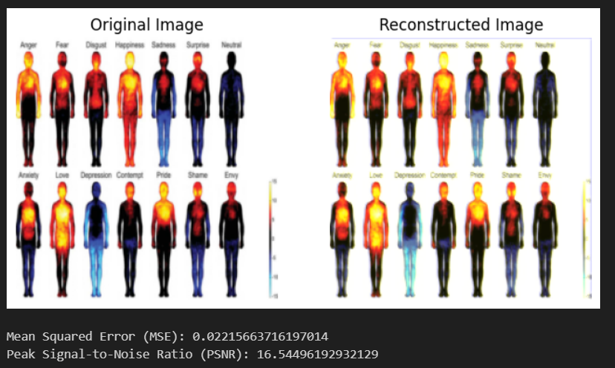
RESULTS

Slide 9
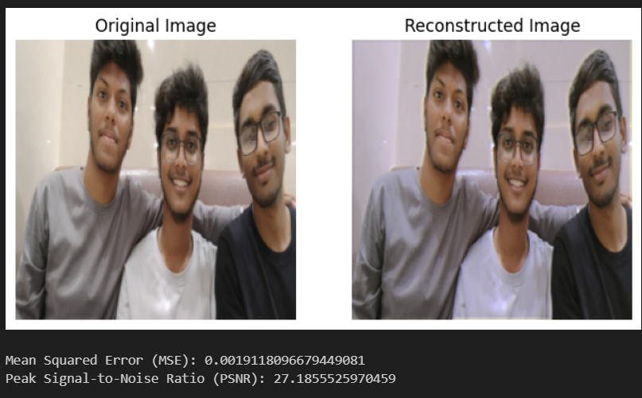
RESULTS

Slide 10
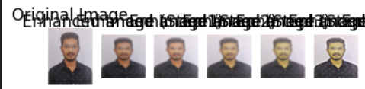
RESULTS

Slide 11
FUTURE SCOPE
Enhanced Feedback Mechanism: Developing a more sophisticated feedback mechanism could enable the model to learn from a wider variety of feedback sources
Application to Various Domains: The methodology could be adapted for diverse domains such as finance, healthcare, and IoT, where dynamic reporting on complex data patterns is valuable.
Integration with Real-Time Data Streams: Expanding the system to work with live data streams would enable real-time report updates, providing immediate insights and supporting timely decision-making.

Slide 12
CONCLUSION
A novel approach to adaptive report generation by integrating Deep Q-Network (DQN) reinforcement learning with Inverse Variance Transformation (IVT). By autonomously adjusting report parameters based on data insights, the DQN model enables dynamic, high-quality reporting, reducing manual effort and enhancing adaptability. IVT contributes to this process by ensuring statistical reliability, balancing feature variances, and improving report interpretability. Together, these methods create a scalable, feedback-driven system that evolves over time, continuously refining reports based on user feedback and changing data patterns.

Slide 13
THANK YOU!

